Slide 1

Twitter Real-Time Sentiment Analysis
Tiancheng Shi, Yuanchen Wei

Slide 2
Motivation
Twitter is a popular social media for self-expression. The sentiment of a user posting a tweet can oftentimes generate insightful results.
The project group is primarily motivated to develop a real-time machine learning model to assess the sentiment – positive or negative – that a tweet implies.
Goal
NLP embeddings on classified tweets from Kaggle, and perform sentiment analysis on data using regression models.
Extract and preprocess tweets from Twitter API as the test set.
Predict the streaming tweets with trained model, and visualize the performance using JavaScript, BigQuery, etc.

Slide 3
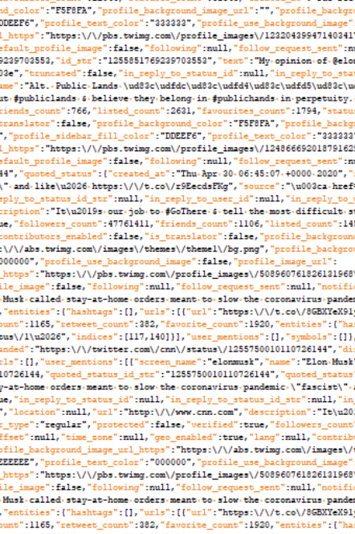

Data
Static data: Kaggle
Volume: 1.6 million tweets
Variety: each tweet is associated with an ordinal sentiment value from 0 (negative) to 4 (positive).
Streaming data: Twitter API Tweepy
Velocity: ~3000 tweets / sec, possibly filtering by several tags of interest.

Slide 4
Methods
Data Preprocessing Techniques (NLP):
Bigram, trigram
Stopwords
Vader
Word2Vec
Classification Models:
Logistic Regression and its variants (Polynomial, etc.)
Decision Tree and its variants (Random Forest, XGBoost, etc.)
Multi-Layer Perceptron (Neural Networks)

Slide 5
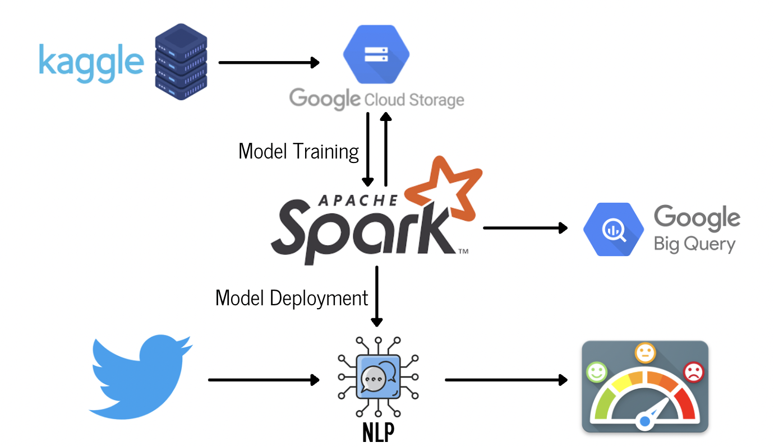
System
Notes:
This is the overview of our system. As you can see we input kaggle dataset into cloud storage as training set. Once we have trained a satisfying model for NLP tasks, we will apply the model on the streaming data from twitter api. After the sentiment analysis is finished, we will load the data into big query and do further visualization. We may also use some other analytics tools such as JavaScript or RStudio in the future.

Slide 6
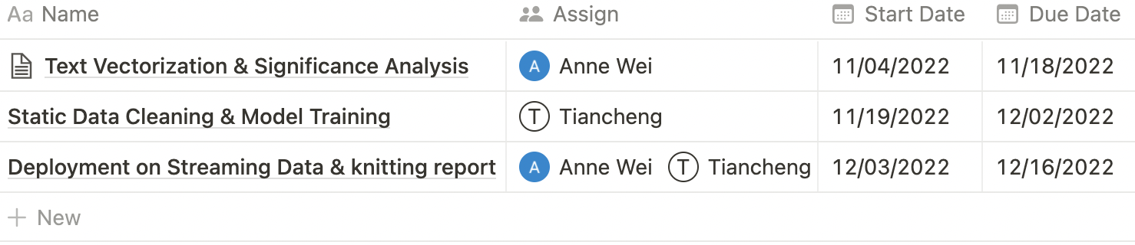
Schedule

Slide 7
Reference
http://ipullrank.com/wp-content/uploads/2017/04/sentiment-analysis-tools-1400.jpg
https://www.kaggle.com/datasets/kazanova/sentiment140
https://towardsdatascience.com/simple-twitter-analytics-with-twitter-nlp-toolkit-7d7d79bf2535

